Slide 1

Why Do Patients Come Back Within 30 Days?
A practical look at predicting hospital readmissions using real patient data
By: Alex Spence
DSC 680 Project 1 Milestone 3
Notes:
Hi everyone, today I’m sharing my first project on predicting hospital readmissions using real patient data

Slide 2
The Problem
Unplanned 30-day readmissions cost billions in penalties (Medicare HRRP)
More importantly: signal gaps in post-discharge care
Goal: Build a model to identify high-risk patients at discharge → enable targeted interventions (calls, home health, med reconciliation)
The business problem is clear: hospitals need better ways to spot risk early so they can actually prevent returns.
Notes:
Every year hospitals lose billions in penalties because too many patients return within 30 days. More importantly, those readmissions usually mean something went wrong after they left — maybe medications weren't explained well, no follow-up appointment, or social issues got missed. My goal was to build something that could flag high-risk patients right at discharge so care teams can step in."

Slide 3
Data & Cleaning
Source: UCI Diabetes 130-US Hospitals dataset (1999–2008)
Raw: 101,766 encounters, 50 features
After cleaning: 99,280 rows, 110 features
Key steps:Removed leakage (death/hospice/transfers)Converted ? → NaN, dropped high-missing columns
One-hot encoded categoricals, simplified diagnosis codes
Target: binary readmission <30 days (11.4% positive)
Notes:
"I used the public Diabetes 130-US Hospitals dataset from UCI — over 100,000 hospital stays from 1999 to 2008. After heavy cleaning — dropping IDs and high-missing columns, fixing encoded missing values, removing patients who died or went to hospice to avoid leakage, one-hot encoding, and grouping diagnosis codes — I ended up with about 99,000 encounters and 110 features. The 30-day readmission rate was roughly 11.4%."

Slide 4
Methods
Split: 75/25 stratified train/test
Baseline: Approximate LACE score recreation
Main model: XGBoost (with class weighting & early stopping)
Interpretability: SHAP values
I chose XGBoost because it handles tabular data well and gives good explanations via SHAP.
Notes:
I started with a recreated approximate LACE score as a clinical baseline, then moved to XGBoost because it usually performs well on tabular health data. I handled class imbalance with scale_pos_weight, used early stopping, and focused on interpretability with SHAP values.

Slide 5
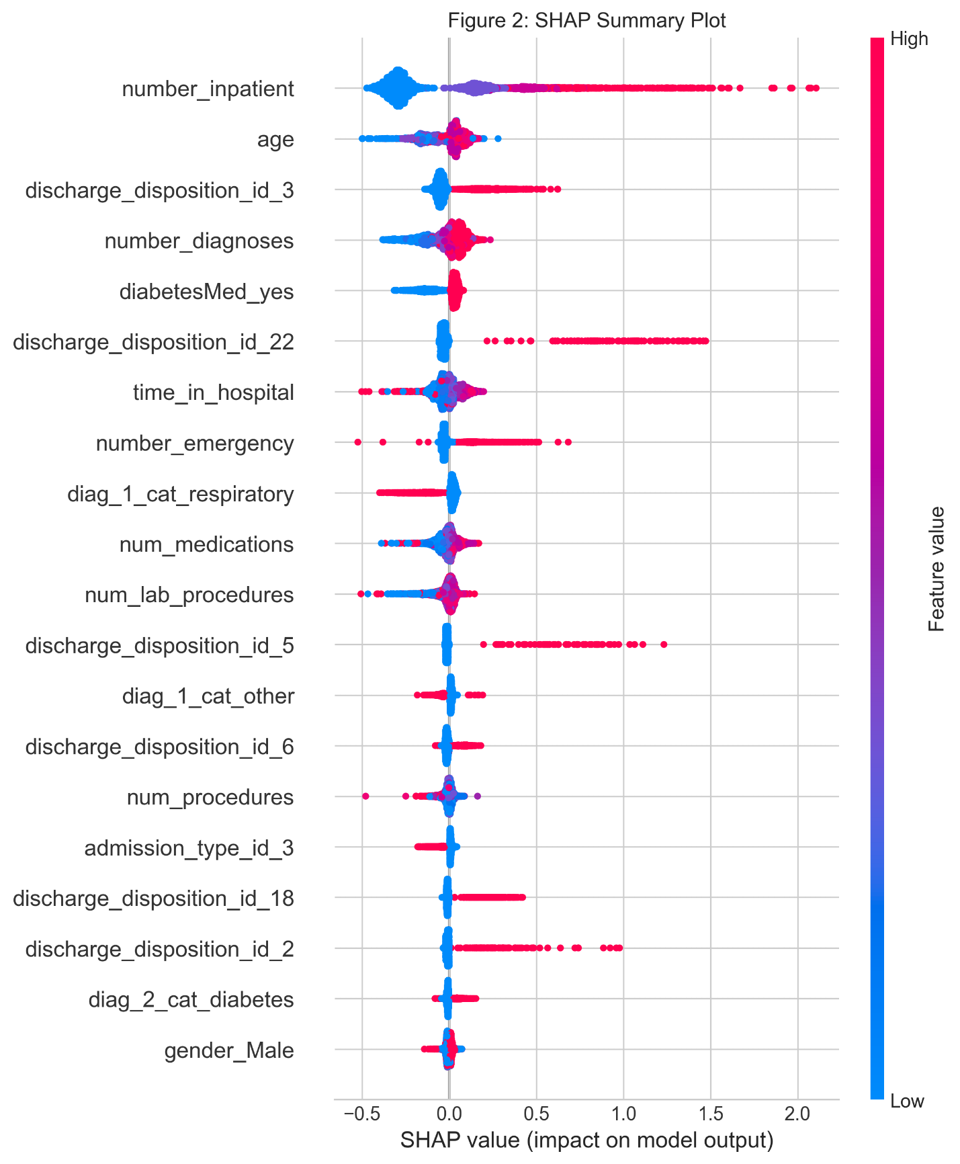
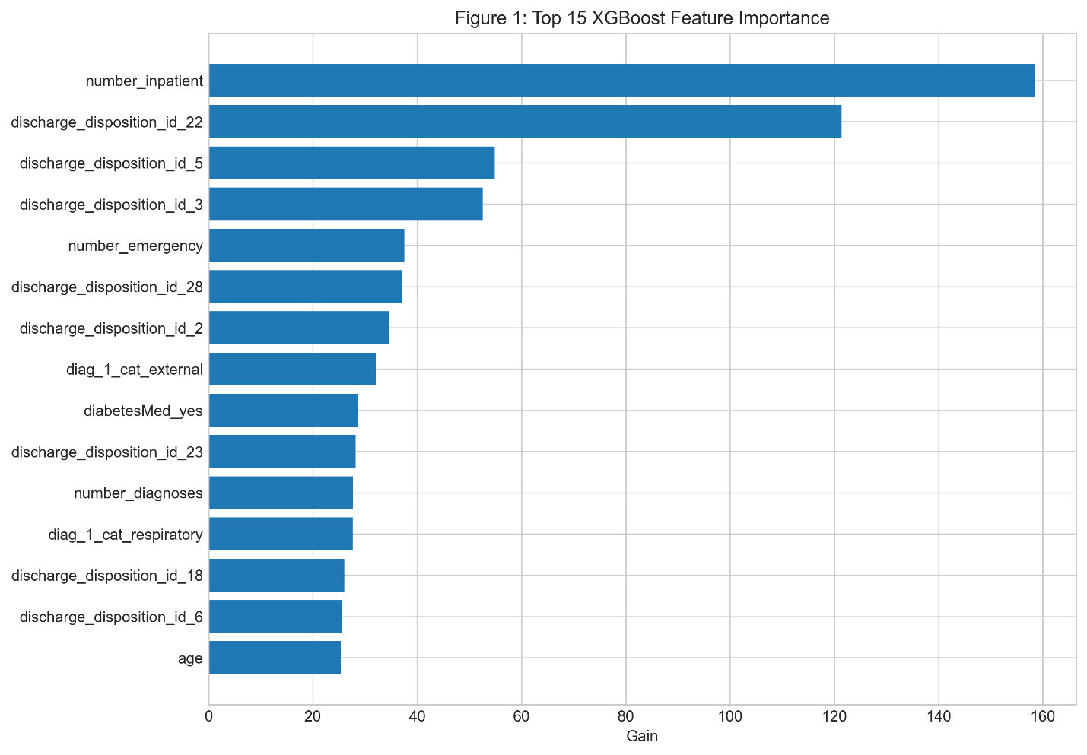
Results & Key Figures
Performance: AUC-ROC = 0.661 (aligns with published benchmarks ~0.66–0.67)
Notes:
(Show Figure 1 – feature importance) "The model achieved an AUC of 0.661 on the test set — which actually matches published results on this exact dataset pretty closely. The strongest predictors were number of prior inpatient visits, medication changes, discharge disposition, emergency visits, and number of medications."
(Show Figure 2 – SHAP summary) "SHAP confirms the same story: more inpatient visits push risk way up, medication changes are a big red flag, and so on."

Slide 6
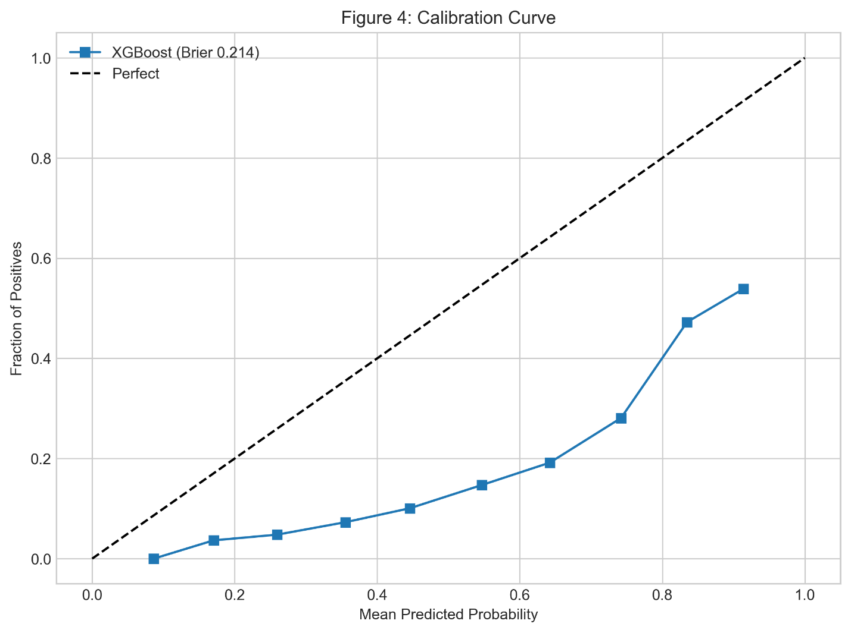
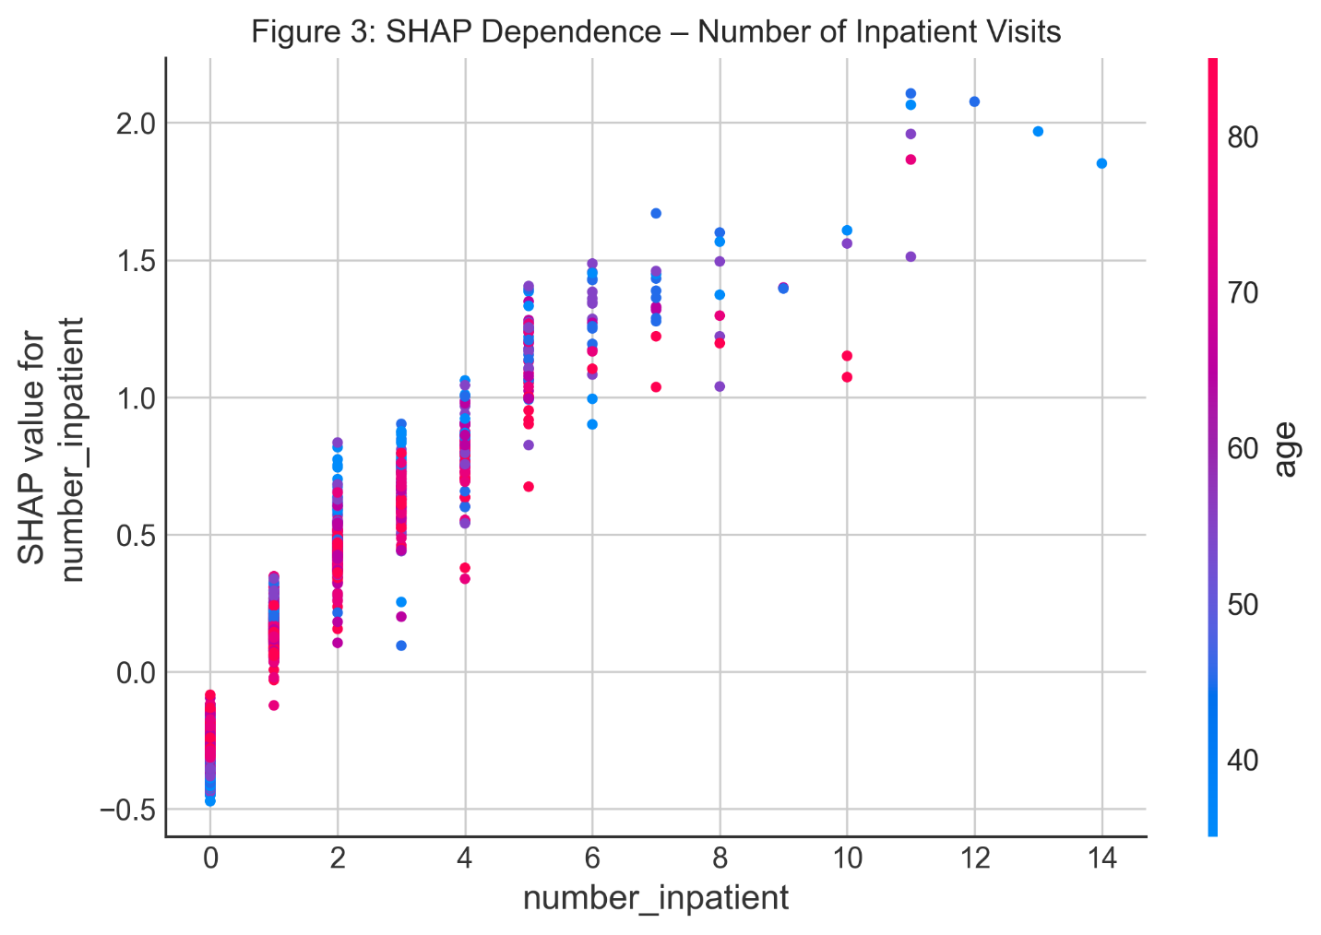
Interpretation
Notes:
(Show Figure 3 – dependence plot) "Here's a closer look at the top driver — the more inpatient visits in the past year, the higher the predicted risk. This makes intuitive sense; these are the classic 'frequent flyers' clinicians worry about."
(Show Figure 4 – calibration curve) "The calibration is reasonable — predicted probabilities line up decently with actual outcomes. The Brier score was low, showing good overall reliability."

Slide 7
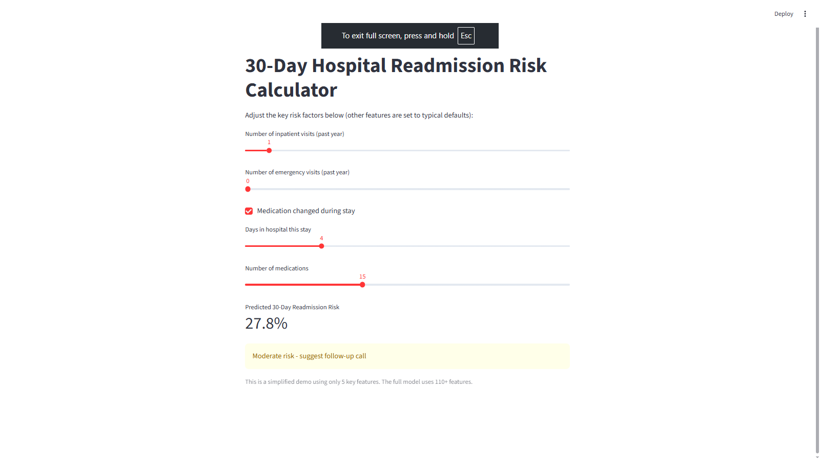
Practical Demo
Notes:
"I turned the insights into a simple interactive calculator. A discharge planner can slide five key factors and instantly see a risk percentage with a color-coded alert.

Slide 8
Recommendations
Flag patients with ≥3 prior inpatient visits or medication changes
Add medication reconciliation + 48-hour follow-up call when changes occur
Integrate simple risk score into discharge workflow
These are low-hanging, high-impact actions based directly on the model’s top drivers.
Notes:
"My main recommendations: automatically flag anyone with multiple prior inpatient visits or medication changes for extra follow-up.

Slide 9
Ethics & Limitations
Ethics: Comparable AUC across racial groups; small false-negative difference noted
Positioned as decision support only
Limitations: Old data (pre-2010), diabetes-only
I was careful with bias checks and transparency, this is a tool to assist, not override, clinicians.
Notes:
checked for bias — performance was similar across racial groups. Importantly, this is decision support only, never a replacement for clinical judgment.“The biggest limitations are that the data is old and only covers diabetes-related stays. No social determinants like housing or transportation. Next steps would be retraining on modern local hospital data

Slide 10
Closing
Learned: Healthcare data is noisy but interpretability is critical
Thank you for watching!
Notes:
That's my project. I learned a ton about real-world healthcare data challenges and how interpretability matters just as much as raw performance. Thanks for watching — I'm happy to answer any questions!"

